Slide 1
CS4930 Semester Project
Aziz Alghamdi & Owen Kalbfleisch

Slide 2
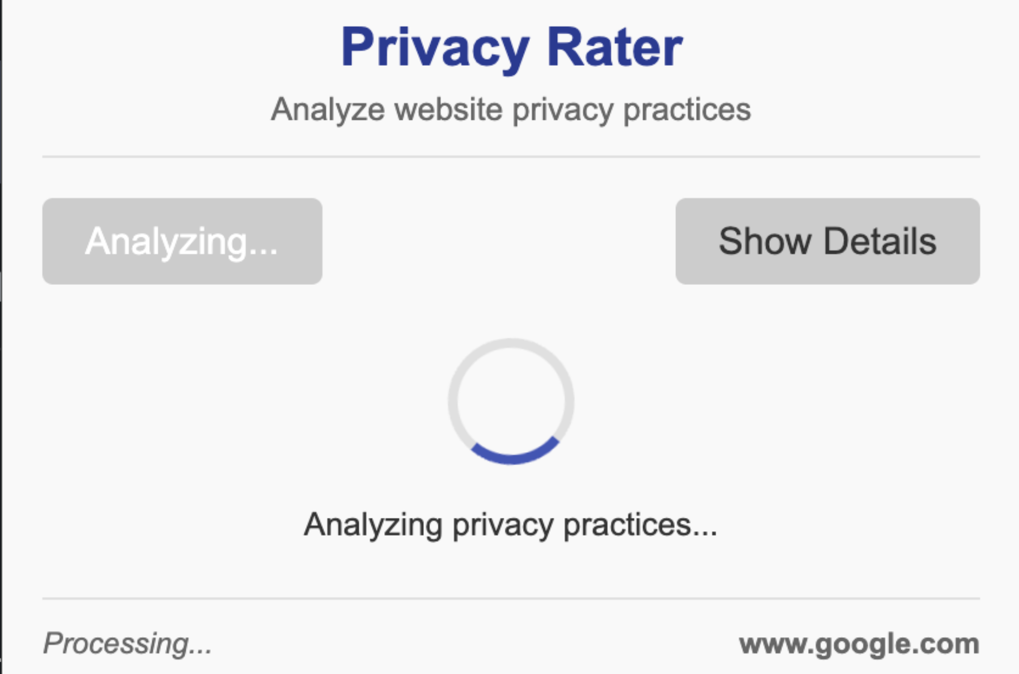
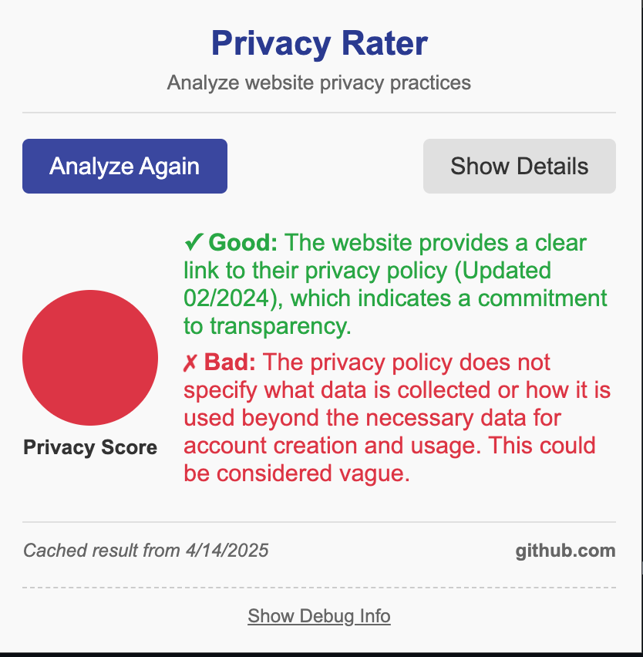
About our Project
Our semester project is a browser extension that helps users understand how private and secure the websites they visit really are. It checks for things like trackers, cookie behavior, and whether the site uses secure connections. It uses AI to review the site's privacy policy and gives the website an easy-to-understand privacy score. This helps users make smarter choices about which sites they trust with their personal information.

Slide 3
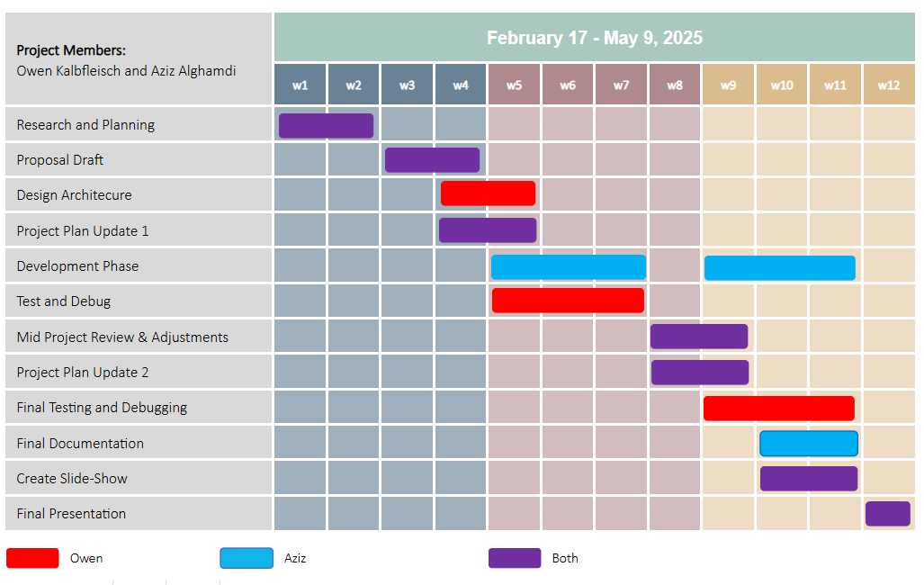
Project Schedule

Slide 4

Configuration Management
GitHub
  We used GitHub to track changes, collaborate on code, and maintain version control throughout the development process. It allowed us to manage updates and ensure the stability of our browser extension.

Slide 5

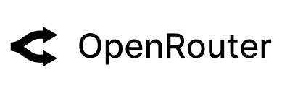
Project Design
HTML
  Used to structure the extension's popup interface and settings page, defining the layout of elements like buttons and rating displays.
JavaScript
  Handles DOM manipulation, user interactions, privacy analysis logic, and communication with APIs and background scripts.
OpenRouter
  Used to integrate AI models via API calls, enabling natural language analysis of privacy policies or generating privacy ratings based on website behavior.

Slide 6
Project Design Cont.
User Interface (UI)
Popup Window: Appears when the extension icon is clicked
  Displays privacy score (color-coded or numerical)
  Basic info about trackers, cookies, and connection security
  Button for detailed policy analysis
Core Components
Content Script
  Injected into websites to detect trackers and cookies
  Sends data to background script
Background Script
  Handles API calls and logic
  Communicates between content script and popup
  Calls OpenRouter API for AI-based policy analysis
Privacy Rating System
Combines multiple factors:
  Number and type of trackers
  HTTPS usage
  AI-generated analysis of privacy policy
Assigns overall score (e.g., A–F, 1–10 scale, or color levels)
OpenRouter Integration
Sends website privacy policy text to AI
Receives summary and trustworthiness score
Displays AI feedback in the popup
Permissions & Manifest
manifest.json defines extension settings
  Required permissions: access to visited websites, storage, scripting, etc.
  Scripts registered here

Slide 7
Demo
https://github.com/owenkalb/Website-Privacy-Rating-Extension

